Slide 1
Competence-Driven
Active Learning
Charles McCarthy
(Supervisor: Dr. Derek Bridge)

Slide 2
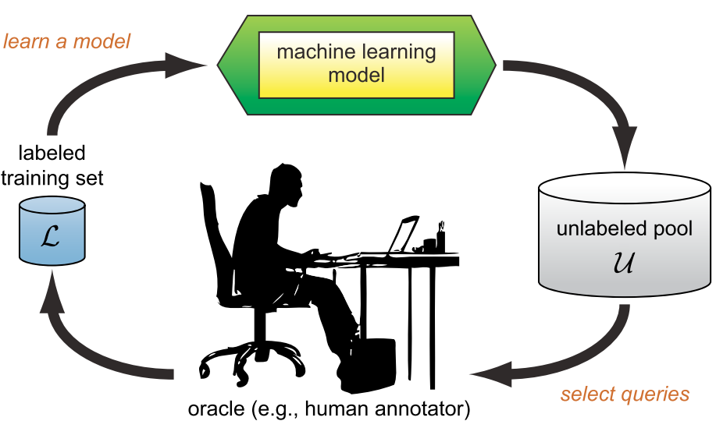
Active Learning
(Pool Based)

Slide 3
Pool-Based Active Learning Fundamentals (1)
Case
  Individual data instance within the domain, characterized by attributes and a label (which may be known, or unknown).
Case Base
  The labelled set of examples that we have at our disposal
Case-Based Classification using k-Nearest-Neighbours
  Use the Case Base with a kNN Classifier to perform classification
Unlabelled Pool
  The large pool of Unlabelled Cases

Slide 4
Pool-Based Active Learning Fundamentals (2)
Oracle
  Entity with the capability to Label unlabelled examples
Selection Strategy
  The algorithmic approach taken in selecting Cases from the Unlabelled Pool to query against the Oracle
System Competence Gain
  The improvement in the capability of the overall system to classify new instances
Stopping Condition
  The Condition at which the system may no longer query the Oracle for Labels (e.g. Oracle budget of 50 Labels)

Slide 5
Pool-Based Active Learning Example Application Areas
Recommendation Engines
  The user is the Oracle
Text Classification
  Spam / Ham
  Sentiment Analysis
  Etc.
Computer Vision
  Vast quantities of visual data, and rate of generation very high.
Voice Analysis
  Labelling a very slow process – requires a skilled expert

Slide 6
Competence Models

Slide 7
Competence Models
Competence Models try to represent the capability of a Case Base to classify new examples.
Dr. Sarah Jane Delaney of DIT developed a methodology for creating profiles of Case Bases.
Based on the ability of Cases to assist in classifying / misclassifying other Cases.
She used these for building Case Base Maintenance algorithms.
We wanted to expand on her work, using the profiling technique in an Active Learning context..

Slide 8
Delany's RCDL Case Profiles
Easiest to frame in terms of Nearest Neighbours / Reverse Nearest Neighbours
  Nearest Neighbours (NN):
    A Case's nearest neighbours are the k nearest Cases in the Case Base which would be retrieved in a kNN classification.
  Reverse Nearest Neighbours (rNN):
    A Case C's reverse nearest neighbours are the Cases in the Case Base which have C as a
    Notice that this set for a Case is not bounded to k.
Also need the notion of Classifies and Misclassifies:
  Classifies: A Case C1 classifies another Case C2 if C2 is correctly classified by the Case Base, C1 returned as an NN of C2, and C1 has the same label as C2.
  Misclassifies: As per Classifies, except C2 is incorrectly classified, and C1 has a different label to C2.

Slide 9
Delany's RCDL Case Profiles
Case Profile Sets:
  Reachability:
    ReachabilitySet(c ∈ C) = { t ∈ C : Classifies(c, t) }
    NNs of c with same label to c if c correctly classified. Otherwise empty.
  Coverage:
    CoverageSet(c ∈ C) = { t ∈ C : Classifies(t, c) }
    The rNNs of c for which c classifies (i.e. c is in each rNN's Reachability Set)
  Dissimilarity:
    DissimilaritySet(c ∈ C) = { t ∈ C : Misclassifies(c, t) }
    NNs of c with a different label to c if c is incorrectly classified. Otherwise empty.
  Liability:
    LiabilitySet(c ∈ C) = { t ∈ C : Misclassifies(t, c) }
    The rNNs of c for which c misclassifies (i.e. c is in each rNN's Dissimilarity Set)

Slide 10
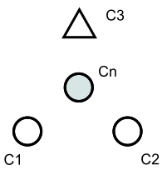
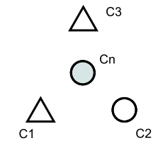
Delany's RCDL Case Profiles
Examples:
  K=3
  Cn is correctly classified by the Case Base
    ReachabilitySet(Cn) = { C1, C2 }
    DissimilaritySet(Cn) = { }
    Cn an element of C2 and C1's Coverage Sets
  Cn is incorrectly classified by the Case Base
    ReachabilitySet(Cn) = { }
    DissimilaritySet(Cn) = { C1, C3 }
    Cn an element of C3 and C1's Liability Sets

Slide 11
Selection Strategy Common Concepts
Distance / Similarity
  It is common to reason about the similarity between two cases (or inversely, how distant they are from one another)
Diversity
  How far away is a Case from the Cases already in the Case Base
  Intuitively, we don't want to add many non-diverse Cases since it will be expending our Oracle budget to add likely redundant data.
Density
  How dense is a particular region of the target domain
  Intuitively, we would like to pick Cases from relatively dense regions of the domain, as we expect that new unseen examples are more likely to come from these regions. Cases from dense regions would be expected to help in classifying more unseen examples than Cases from non-dense regions.
Clustering
  Clustering is sometimes performed on collections of Cases.
  Might be as simple as connected examples within a given distance of one another.
  Can be used to seed the Case Base initially (is a research area in its own right)

Slide 12
(Some) Basic Selection Strategies
Random Sampling
  Simply select examples at random from the Unlabelled Pool.
  Assuming the Pool is representative of the state space (usually we assume it is) – gives a reasonably representative sampling
  Often used as a base for comparing new Selection Strategies
Uncertainty Sampling (Exploitation)
  Select examples from the Unlabelled Pool for which the Case-Base-trained classifier is most uncertain.
  Reasonable, but liable to query outliers – so very susceptible to noise.
Diversity Sampling (Exploration)
  Does not enlist the aid of the classifier at all, instead choosing elements which are far away from everything already in the Case Base
  Benefit of not needing any info regarding labels, but still prone to querying outliers.
Density with Diversity Sampling (Exploration)
  Combines density information with diversity information to try and select diverse examples but from dense regions.
  Tries to ensure outliers have less impact.
  E.g. Rong Hu's EGAL strategy.
Density with Uncertainty Sampling (Exploitation + Exploration)
  Tries to augment Uncertainty Sampling with Density information to avoid querying outliers.

Slide 13
Competence Strategy Suppose Operations
We don't know in advance what label an Unlabelled Case will have when we consider it for addition.
But RCDL profiles rely on this knowledge
Need to be able to 'Suppose' the addition of a Case to the Case Base as different Labels, to see what the RCDL effects would be.
We designed an incremental RCDL Profile building algorithm to make this feasible

Slide 14
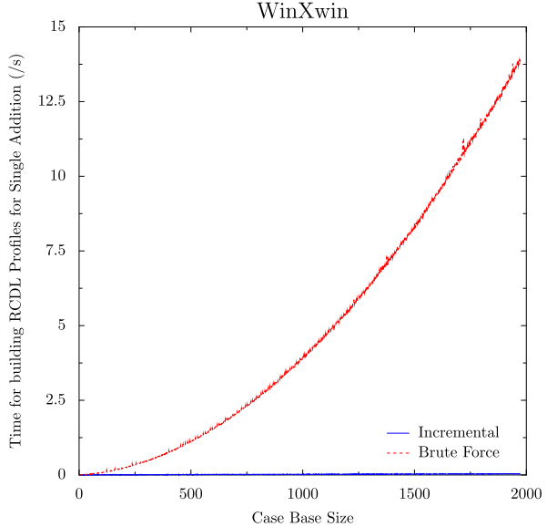
Competence Strategy Suppose Operations
Incremental vs Brute Force Algorithm:

Slide 15
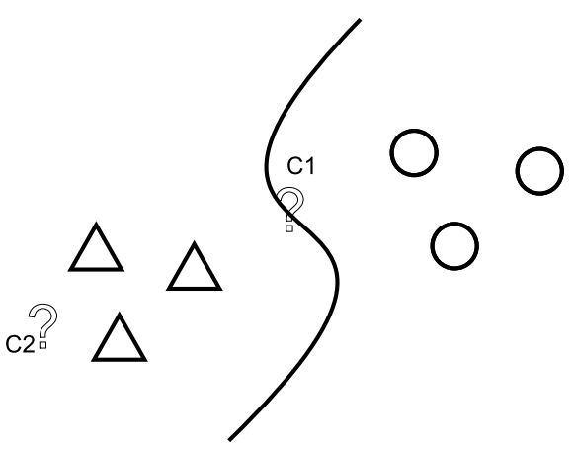
Competence Strategy Suppose Operations
E.g.
In this example, intuitively it would be good to choose C1 over C2
If C1 a circle, classification boundary pushed left.
If triangle – pushed right.
Choosing C2 would be unlikely to cause a change (it's probably a triangle).

Slide 16
(Some) Competence Based Strategies
NRATMin:
  New Case Reachability Added Total Minimisation
NCADMin:
  New Case Coverage Added Deviation Minimisation
NDATMin:
  New Case Dissimilarity Added Total Minimisation
NLATMin:
  New Case Liability Added Total Minimisation

Slide 17
Experimentation

Slide 18
Experimental Platform
Platform built to allow analysis of Selection Strategies in Pool Based Active Learning
2.5k+ LOC of Python
Used many Open Source libraries in completing in such a limited time
Capability to define Selection Strategies in Python
  Also customisable definitions of Oracles, Stopping Conditions, Machine Learning Classifiers, Cases, Distance Metrics, Data Folds
Allows execution and comparison of these Selection Strategies
Variety of outputs to aid experimental analysis (e.g. Plots, tabular experiment summaries, selection graphs).

Slide 19

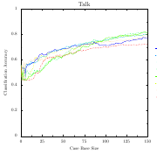
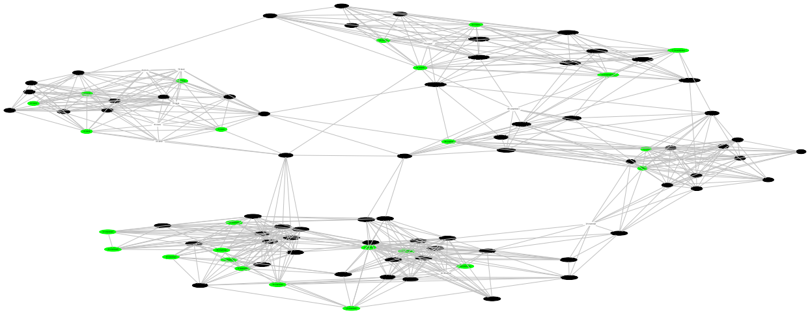
Platform Architecture
Interoperable Files
Data Loaders
Experiment Definition
Experiment Results Store
Experiment Executor
(test.py)
Distance Computation, Caching, Serializing
Experiment Results
Raw Data Files
Plot
Generator
Selection Graph
Generator
Experiment
Summary
Notes:
http://openclipart.org Used to get some O/S icons

Slide 20
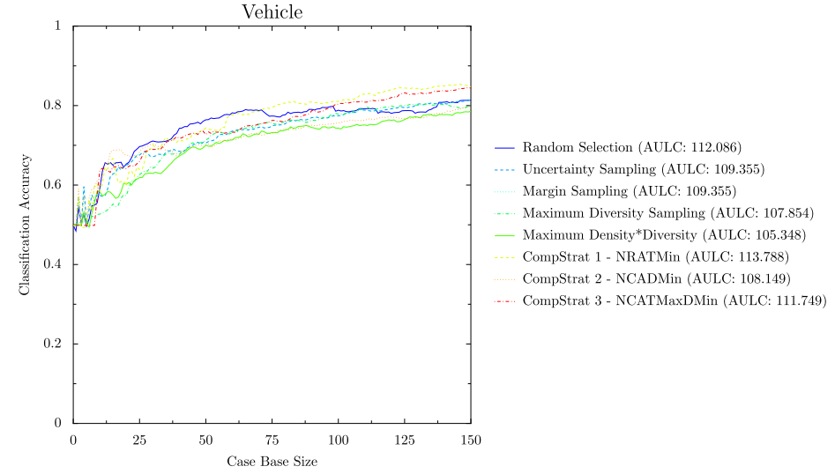
Experimental Results
e.g
(Consult Full Report for complete results)

Slide 21
Future work opportunities

Slide 22
Future work opportunities
Perform statistical analysis on Supposes for multiple data sets to better understand distribution of types of Case Profile changes
Incorporate additional techniques to the simple RCDL based strategies
Investigate Case Base Maintenance Algorithms using the Incremental Case Profile Building and 'Suppose' approach
Improve and expand visualization capabilities to remove the 'black-box' experimentation approach.

Slide 23








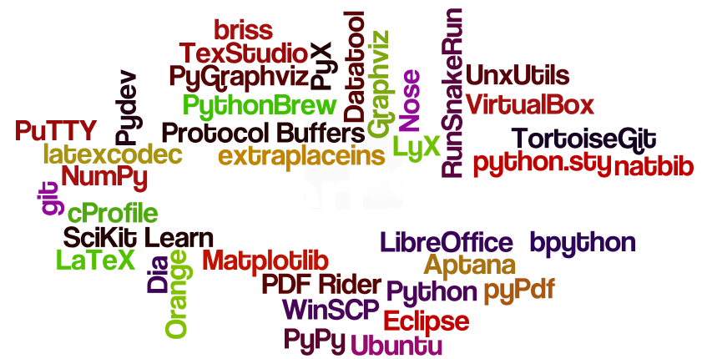














Open Source

Slide 24
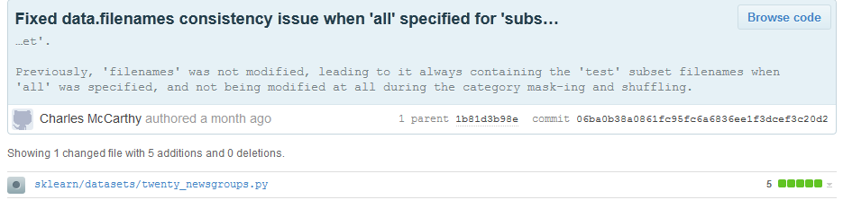
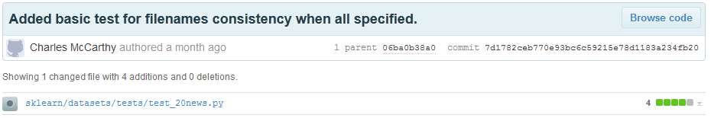
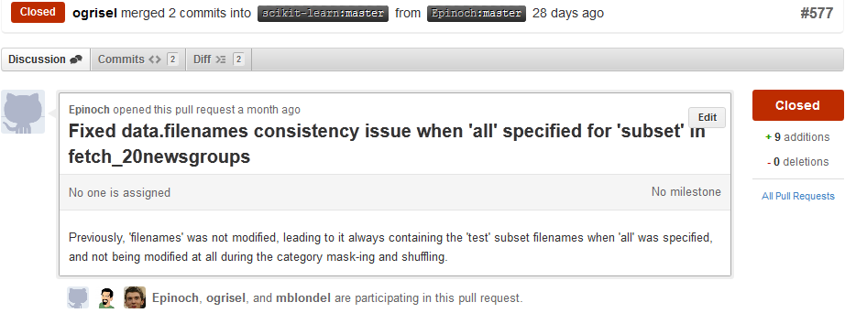
First O/S Contribution
(https://github.com/scikit-learn/scikit-learn/pull/577)

Slide 25
First O/S Contribution
Noticed an inconsistency regarding file names when loading all 20-newsgroups textual data in SciKit-Learn
Stepped into the source (very easy with Eclipse + PyDev!) - found a bug
Fixed the bug – consulted the SciKit-Learn wiki on how to make a contribution (turned out to be very easy!)
Forked on github, committed the change and initiated a pull request to the SciKit-Learn maintainers
Maintainers reviewed, but wanted a unit test first.
Added unit test and committed.
Maintainers accepted and merged into the main branch.
Total turn around < 1 day

Slide 26
O/S Learnings & Conclusions
Project would not have been feasible without heavy re-use of existing components
Good O/S alternatives even for e.g. MS Visio (Dia)
Much nicer to be able to look and debug through implementations of components vs using closed ones. Also easier to develop with when you can see the internals.
Relatively straightforward to contribute back after the initial hurdle overcome
(You can do pretty decent presentations in LibreOffice!)

